Slide 1
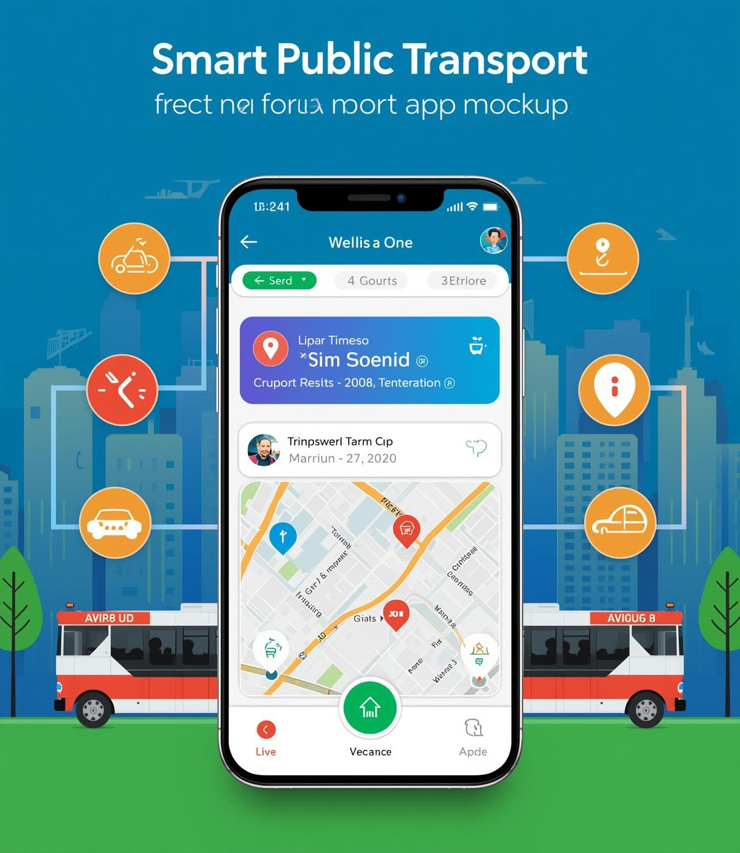
SMART PUBLIC TRANSPORT SYSTEM
Presented by : SPARTANS

Slide 2
Introduction
Public transportation is essential for daily commuting, but it presents challenges for visually impaired users. This project proposes a Smart Public Transport System App designed to make public transport accessible to both blind and general users.

Slide 3
Problem Statement
•Lack of accessibility features in current public transport apps
• Difficulty in navigation and route identification for visually impaired users
• Limited real-time information and safety support

Slide 4
Objective
• Develop an inclusive transport application for all users
•Enable independent travel for visually impaired individuals
• Provide real-time updates and voice assistance for better accessibility

Slide 5
Key Features
• Voice-guided navigation
• Real-time bus and route tracking
• Accessible interface for blind users
• Emergency alert feature
• Multi-language support

Slide 6
System Architecture
• User Application (Android/iOS)
• GPS and Map Integration
• Cloud Server for Data Storage
• Public Transport APIs
• Voice Recognition and Text-to-Speech Modules

Slide 7
Working Flow
User logs in to the app
2. Selects destination via voice or text input
3. App suggests routes and transport modes
4. Real-time tracking and voice updates during journey
5. Alerts and notifications for stops and safety events

Slide 8
Technologies Used
• Mobile Platforms: Android, iOS
• GPS and Location APIs
• AI for Speech Recognition
• Cloud Database (Firebase, AWS)
• IoT for Smart Bus Sensors

Slide 9
Benefits & Impact
• Promotes inclusivity and independence for blind users
• Enhances commuter experience with real-time updates
• Encourages adoption of smart city technologies
• Improves safety and reliability of public transport

Slide 10
Conclusion & Future Scope
This Smart Public Transport App demonstrates how technology can bridge accessibility gaps in urban mobility. Future scope includes integration with wearable devices, AI-based route prediction, and nationwide implementation.

Slide 11
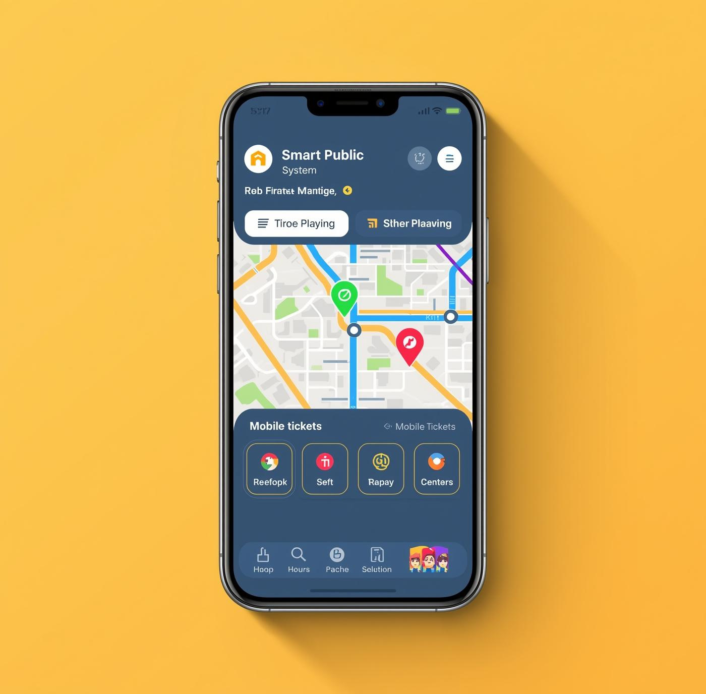
Thank You

